Slide 1

Page 1
My Portfolio
MUHAMMAD MUZAMIL
Social Media Activist
Delivering Digital Growth through Strategic Social Media Marketing

Slide 2

Page 2
About Me
Creative and results-driven social media manager with over 5 years of experience in crafting and executing successful social media strategies. Proven track record of increasing brand awareness, engagement, and follower growth through innovative content and targeted campaigns

Slide 3

Page 3
EXPERIENCE
Social Media Manager Leopard Courier.Pak
Social Media Promotions
i.e Instagram , Facebook..
Developed and executed a comprehensive social media strategy resulting in a 40% increase in engagement rates. Created and managed content calendars, ensuring consistent and timely posts that aligned with brand messaging. Utilized analytics tools and monitor performance and provide actionable insights to improve campaigns.
Led community management efforts, engaging with followers, responding to comments, and fostering a positive online community. Designed and implemented paid social media campaigns achieving a 25% increase in lead generation. Collaborated with marketing and design teams to create visually appealing and effective social media content.

Slide 4
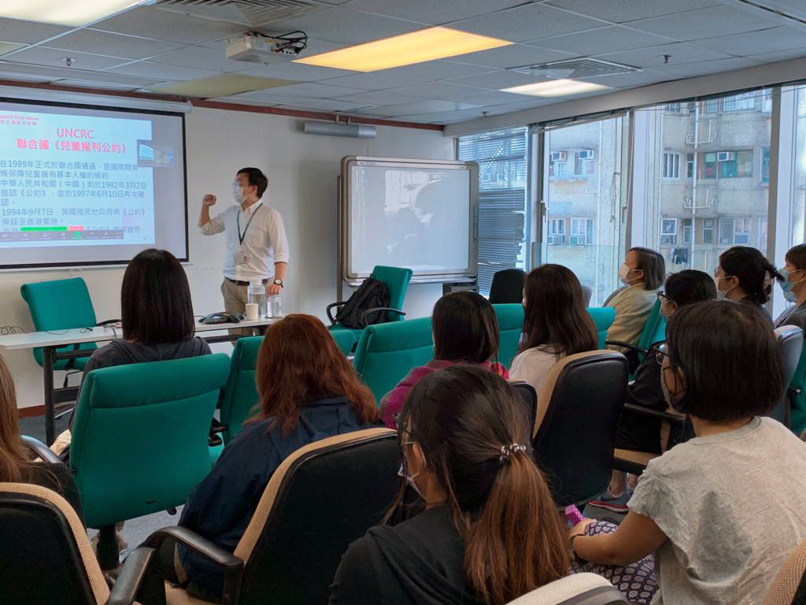
Page 4
EDUC-ATION
Intermediate
Sir Syed college Rawalpindi
2020- 2022
iT Advance Diploma
AGT Institute Rawalpindi
2024- 2025

Slide 5
Page 5
  Social Media Strategy
  Content Creation
  Community Management
  Analytics & Reporting
  Paid Social Media Advertising
SKILLS

Slide 6







SOCIAL MEDIA STRATEGY DEVELOPMENT
Page 6
Creating a strategic social media plan tailored to business goals involves aligning social media activities with the company's overall objectives, target audience, and brand message. Here’s a step-by-step guide to crafting an effective plan:
  Define Your Business Goals
  Identify Your Target Audience
  Choose the Right Social Media Platforms
  Brand Voice and Consistency
  Content Strategy
  Set SMART Goals

Slide 7





SOCIAL MEDIA CAMPAIGNS
Page 7
A successful social media campaign is one that achieves specific business goals, engages the target audience, and generates measurable results. To illustrate, here’s a breakdown of key elements and examples of successful social media campaigns
KEY ELEMENTS OF A SUCCESSFUL SOCIAL MEDIA CAMPAIGN
Clear Goals
Understanding the Audience
Creative Content
Platform Optimization
Engagement and Interaction

Slide 8


Audience Engagement and Growth
Page 8
Audience engagement and growth are essential for building a loyal and active following on social media. Engagement refers to the interaction between your audience and your content (likes, comments, shares, clicks), while growth focuses on increasing your follower base and extending your reach. A strategy for both involves creating meaningful connections, fostering conversations, and providing value to your audience.
Here’s a step by step guide to boost audience engagement and growth
  Understand Your Audience
  Post High-Quality and Relevant Content
  Be Consistent with Posting
  Encourage Interaction
  Engage with Your Audience Actively
  Collaborate with Influencers and Partners

Slide 9

Paid Social Media Campaigns
Page 9
Paid social media campaigns involve using advertising features on social media platforms to promote content, products, or services to a targeted audience. Here’s a detailed guide on paid social media campaigns:
  Defining the Goals of a Paid Social Media Campaign
  Selecting the Right Platform
  Choosing the Ad Format
  Targeting the Right Audience
  Budgeting and Bidding Strategies
  Analyzing Results and Reporting
A paid social media campaign can be a powerful way to achieve business goals, but it requires strategic planning, thoughtful execution, and continuous optimization. By targeting the right audience, using compelling content, testing different approaches, and carefully monitoring performance, you can maximize the impact of your campaigns and drive meaningful results.

Slide 10
Page 10
Thank You
📞 +92 3415124476
✉ muzamilniazi666@gmail.com
📍 Rwp.Pk

